Slide 1
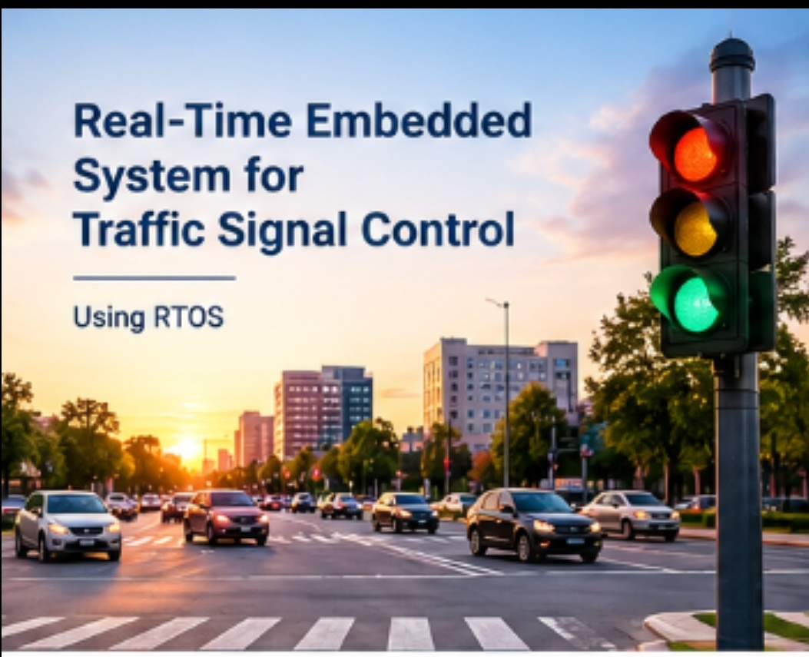
REAL-TIME EMBEDDED SYSTEM
FOR TRAFFIC SIGNAL CONTROL
Operating System Technical Presentation
PRESENTED BY
K.JEEVAN (192525138)
Course : Operating Systems

Slide 2
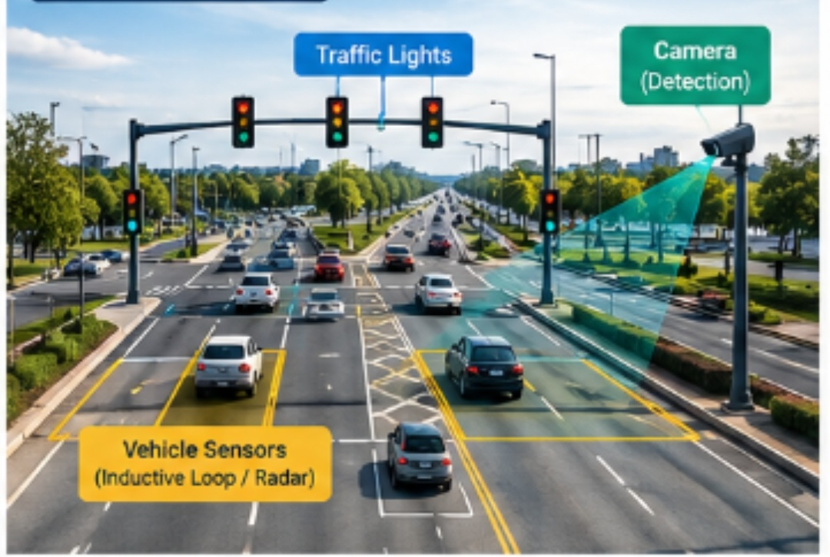
Introduction
Traffic signal control is a time-sensitive embedded application.
Signals must respond to sensors and change lights at the correct time.
The operating system coordinates tasks, timing, input/output and hardware.
A Real-Time Operating System (RTOS) is suitable because predictable response is important.
2

Slide 3
Type of OS Used – RTOS
RTOS stands for Real-Time Operating System.
It is designed to respond to events within predictable time limits.
Hard real-time tasks: missing a deadline can cause unsafe operation.
Soft real-time tasks: occasional delay is acceptable but should be minimized.
Traffic signal control mainly requires deterministic timing and fast response.
3

Slide 4
OS Structure and Components
Kernel – core part that manages CPU, memory and devices.
Scheduler – selects which task should execute next.
Task/Process Manager – creates, controls and terminates tasks.
Timer Manager – provides periodic and one-shot timing services.
Device Drivers – communicate with sensors, LEDs and signal controllers.
Interrupt Handler – responds immediately to hardware events.
5

Slide 5
System Calls for Process Control
create/spawn – starts a new task or process.
terminate/exit – ends a task after completion or error.
wait – allows one task to wait for another task or event.
signal/event functions – notify tasks when an event occurs.
RTOS APIs provide these services between application tasks and the kernel.
7

Slide 6
Working of the System
1. Sensors detect vehicle presence or traffic conditions.
2. Input data is passed to the RTOS through device drivers.
3. The scheduler selects the appropriate traffic-control task.
4. Timer services maintain the required signal durations.
5. The control task changes red, yellow and green outputs.
6. Emergency or priority events can trigger a higher-priority task.
9

Slide 7
Advantages & Conclusion
Advantages:
precise timing, predictable response, priority-based scheduling and reliable operation.
RTOS helps coordinate sensors, timers, signal-control tasks and hardware.
System calls provide controlled access to process and timing services.
Conclusion:
an RTOS is well suited for traffic signal control because timing and response are critical.
Key takeaway: RTOS + scheduler + timers + device drivers = dependable real-time control.
10

Slide 8
Thank You

Slide 9


